Slide 1
Project 1
Observations on Sales Prediction Dataset
Dushyant Pratap Singh
dushyant.singh@iitg.ac.in

Slide 2
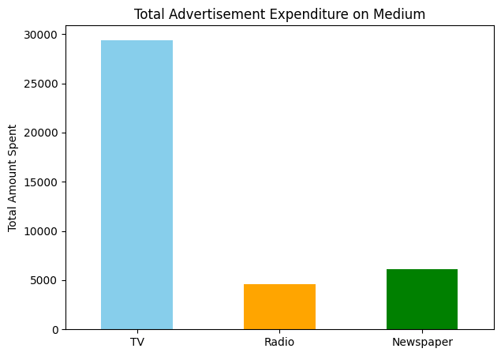
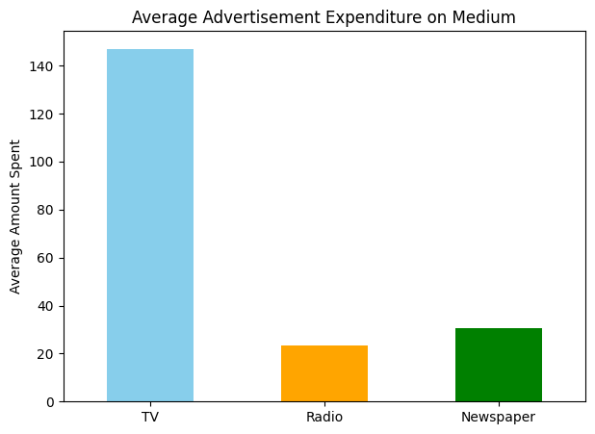
Comparison of Total and Average Advertisement Expenditure on Medium
Above two plots shows that most amount of money has been spent on advertising the product on Television and very less amount has been spent on advertising through Radio.

Slide 3
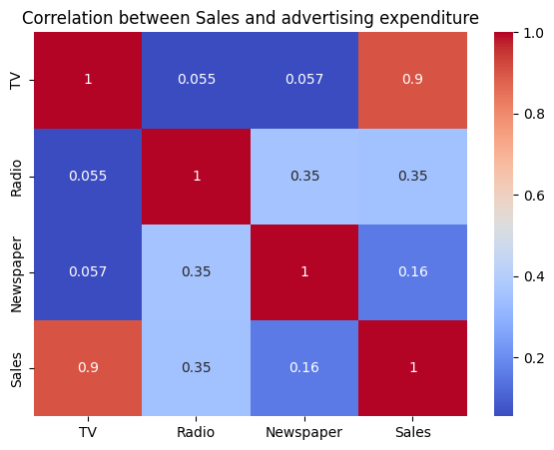
Correlation between Product Sales and Advertising Expenditure on different medium
TV has the strongest positive correlation with Sales (0.90)
TV advertising is the most effective channel in driving product sales.
A company investing more in TV ads is highly likely to see a boost in sales.
Radio has a moderate positive correlation with Sales (0.35)
Radio contributes to sales, but not as strongly as TV.
Radio ads may be more effective in niche markets or combined with other media.
Newspaper shows a weak correlation with Sales (0.16)
Advertising in newspapers has little impact on driving sales in this case.
Spending on print ads may not yield good ROI for this product.

Slide 4
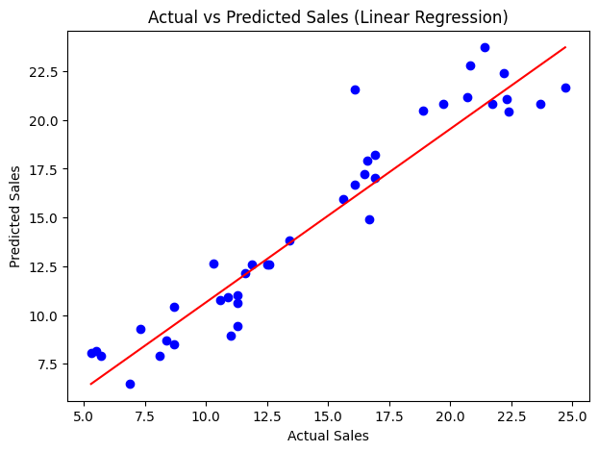
Actual vs Predicted Sales (Linear Regression)
The blue dots (predicted sales) lie close to the red line (ideal predictions = actual values), indicating good model accuracy.
There’s a strong positive linear relationship, meaning the model is effective in capturing the trend in sales data.
The spread of points is relatively balanced above and below the line, indicating the model does not systematically overpredict or underpredict.
This supports the assumption that residuals are randomly distributed, which is good for linear regression.
High predictions align well for high actual sales.

Slide 5
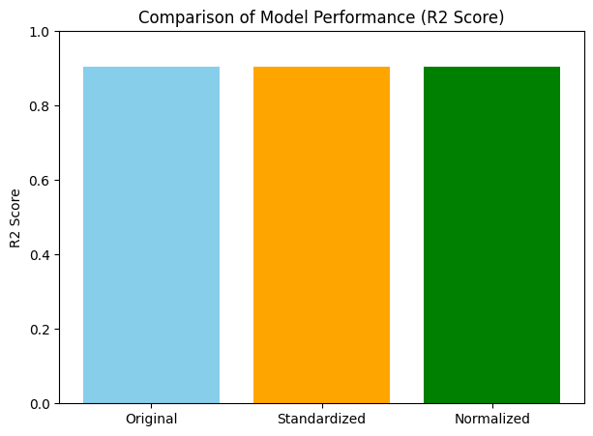
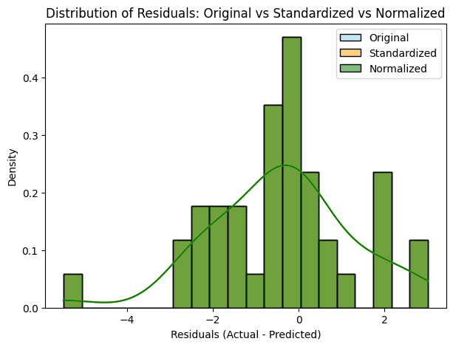
Model Performance after Standardization and Normalization
Linear regression is not affected by feature scaling (normalization or standardization) in terms of predictions and metrics like R2, MSE, and MAE.
The model automatically adjusts its coefficients to account for the scale of each feature.
So, normalizing the features does not change the predictions or the fit for standard linear regression.

Slide 6
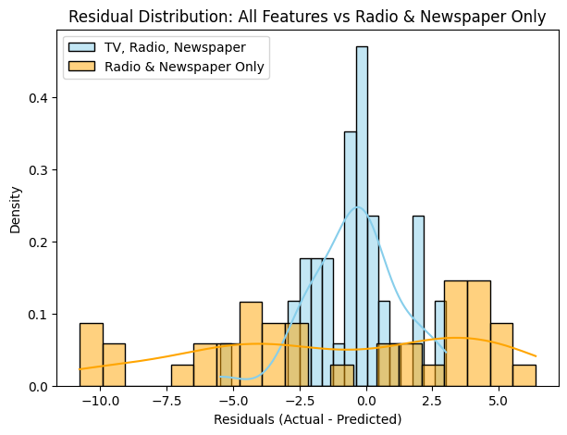
Impact of TV Advertising on Model Accuracy
The blue curve (TV, Radio, Newspaper) is narrower and more centered around 0, meaning its predictions are closer to actual values.
In contrast, the orange bars (Radio & Newspaper only) show a wider spread, indicating more prediction errors.
The model without TV shows larger and more frequent residuals, especially in the -10 to +5 range.
This implies excluding TV weakens the model, confirming that TV has strong influence on sales.
The orange KDE shows multiple small peaks and is not centered around zero, which suggests:
Model is not capturing trends well.
It may have systematic bias (either underpredicting or overpredicting frequently).

Slide 7
Thank you

